Slide 1
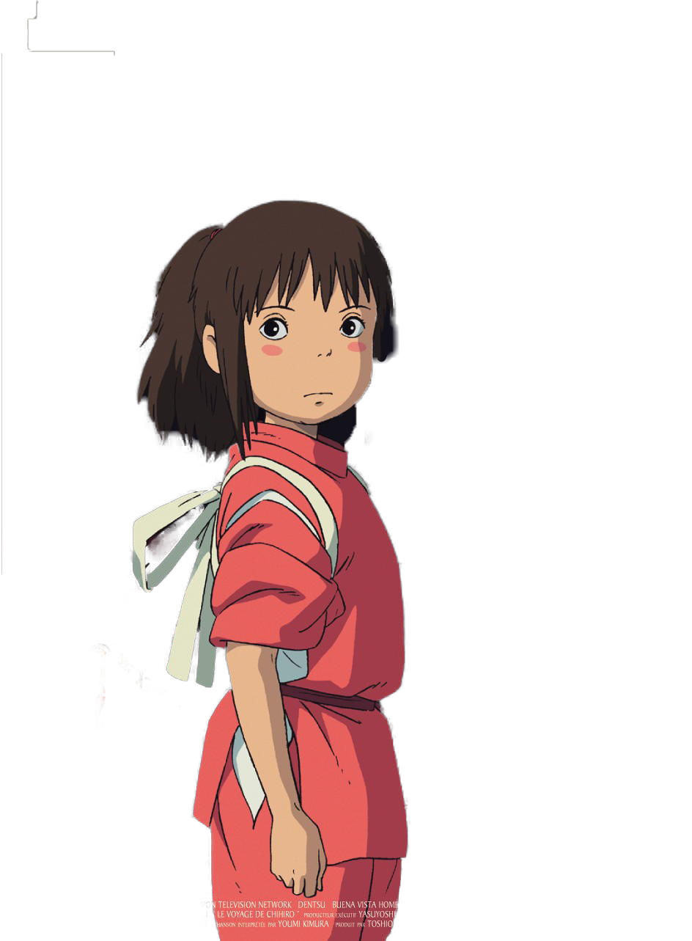
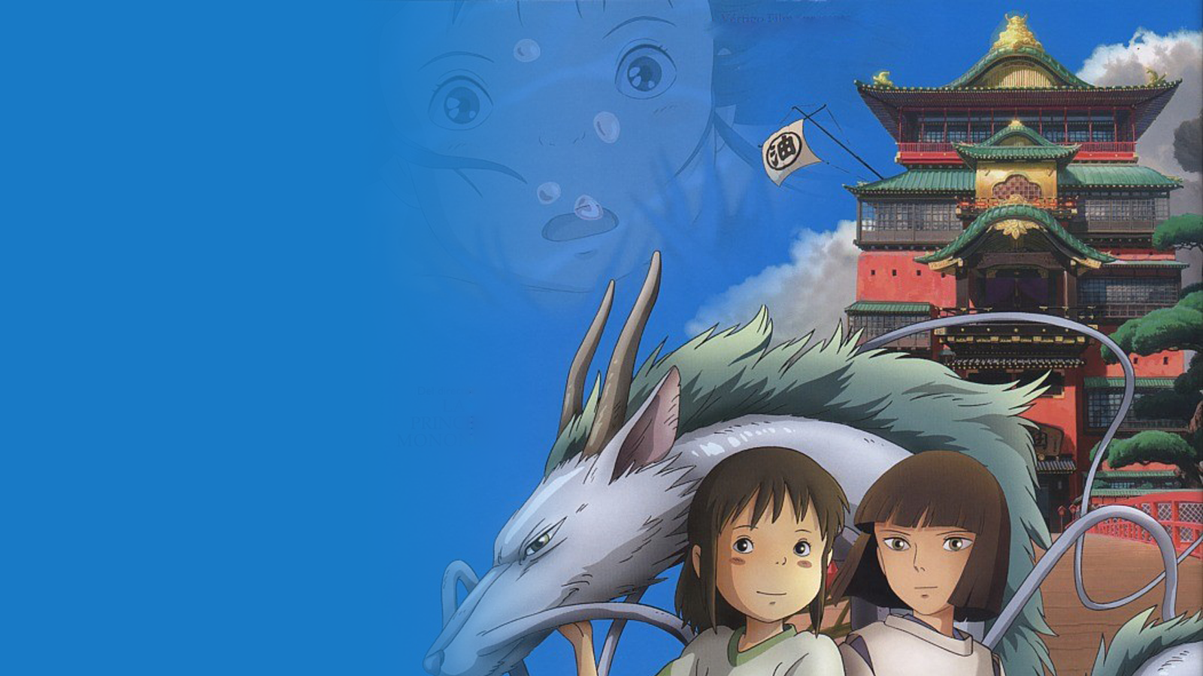
Transfer Your Photo to
Ghibli Cartoon Style
Group 24:
Shihao Piao
Yang Song
Yu Gu
Xuwen Shuai

Slide 2

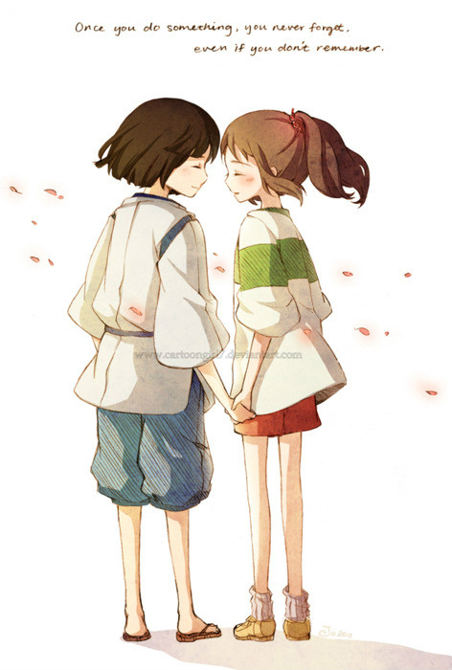
What is Ghibli Style?
01
Studio Ghibli
Co-founded by Hayao Miyazaki.
characterized by its
attention to detail
hand-drawn animation
richly crafted worlds
emotionally resonant storytelling
Notes:
It is characterized by its attention to detail, hand-drawn animation, richly crafted worlds, and emotionally resonant storytelling. Visually, the Studio Ghibli style often features lush and vibrant environments, meticulously designed backgrounds, and intricate character designs.

Slide 3
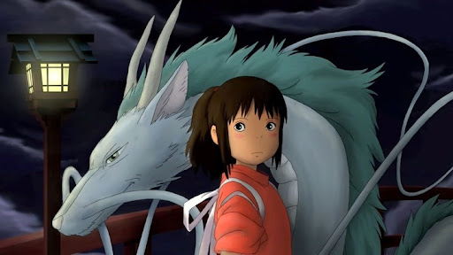
“Spirited Away” 2001
What is Ghibli Style?
01

Slide 4
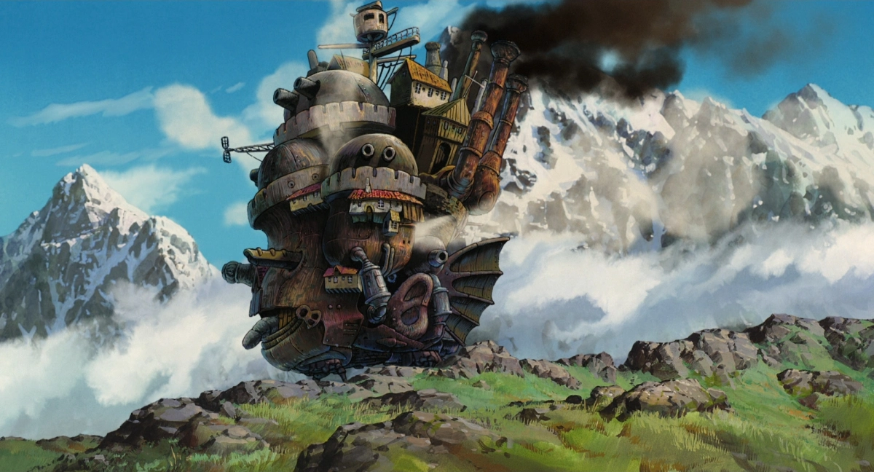
“Howl's Moving Castle” 2004
What is Ghibli Style?
01
Notes:
The mountains are portrayed with gentle colors and soft shadows, while the clouds are drawn with broad, flowing strokes, enhancing the dreamlike quality of the scene.

Slide 5
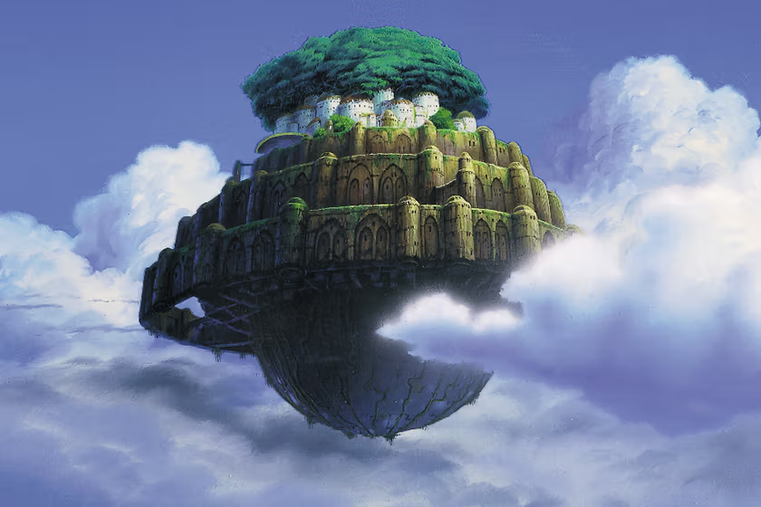
“Castle in the Sky” 1986
What is Ghibli Style?
01

Slide 6
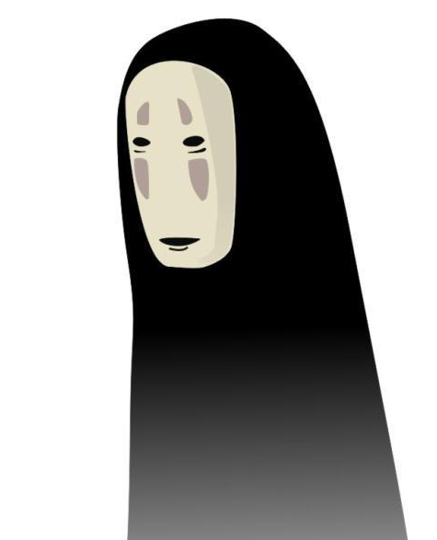
Contribution
Data Collection, Implement NST model - Yang Song
Designing the Generator and Discriminator - Yu Gu
Loss function, code for training and testing - Shihao Piao
Train and finetune the model, Numerical test - Xuwen Shuai

Slide 7

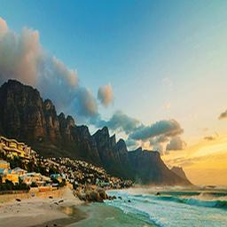
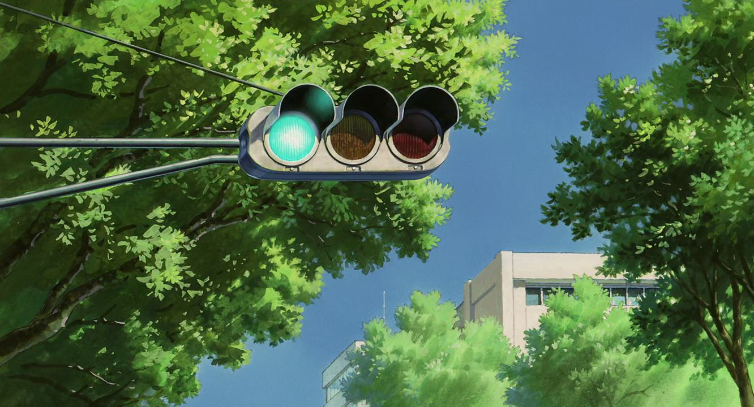
Problem Description
01
Learning Task: CycleGAN, landscape to Ghibli style
Dataset: trainX(1800), trainY(900),testX(160),testY(30)
Reference: “Unpaired image-to-image translation using cycle-consistent adversarial networks.” Zhu, J. Y., Park, T., Isola, P., & Efros, A. A. (2017).
Notes:
Let me introduce The learning task utilizes a form of Cycle-consistency Generative Adversarial Network (GAN) called CycleGAN, tailored for unpaired image-to-image translation. This approach does not require one-to-one mappings between specific images in the source and target styles. We used this model to transfer the landscape image into a Ghibli-style image. We crawled some images and also downloaded some images from the Internet. Finally, we have 1,800 authentic landscape images for the trainX, about 900 Ghibli-style images for the trainY, around 160 landscape images for the testing set testX, and roughly 30 Ghibli-style images for the testY. The sample image in our dataset is shown below. Our reference is Unpaired image-to-image translation using cycle-consistent adversarial networks. The paper shows many different style transfers including hores-zebras and summer-winter.

Slide 8
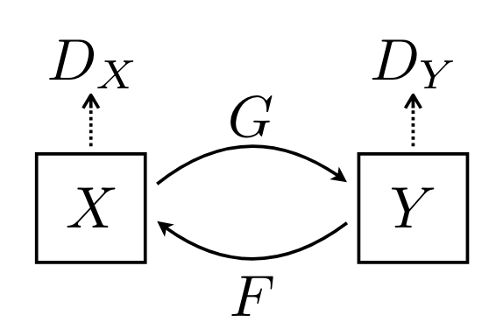
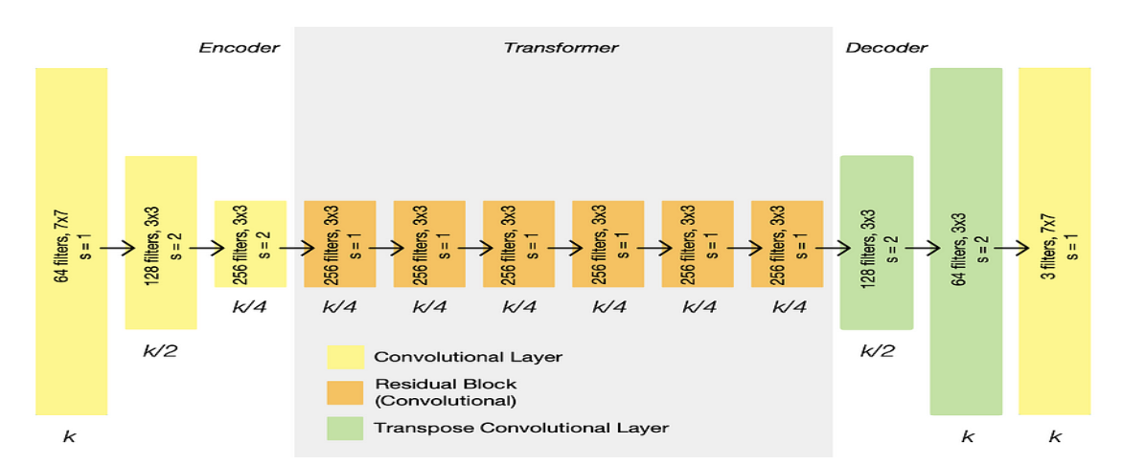
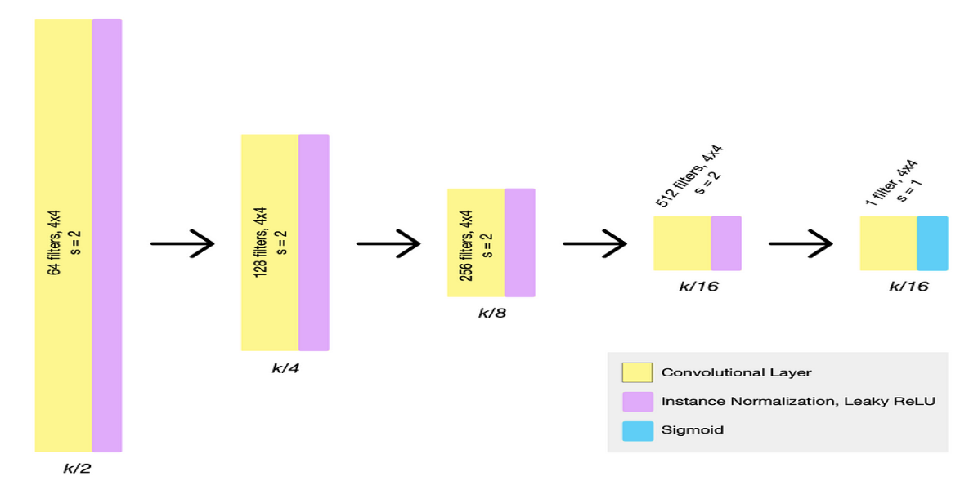
Model Architecture
CycleGAN
Generator
Discriminator
Chanllenges: Training
“Unpaired image-to-image translation using cycle-consistent adversarial networks.” Zhu, J. Y., Park, T., Isola, P., & Efros, A. A. (2017).
Notes:
Our model contains two mapping functions G and F, and associated adversarial discriminators DY and DX. DY encourages G to translate X into outputs indistinguishable from domain Y , and vice versa for DX and F. In the center, we have the architecture of the Generator, which is composed of three parts: the Encoder, Transformer, and Decoder. The Encoder compresses the input, extracting essential features and reducing dimensionality. It's followed by the Transformer, which contains several residual blocks. Finally, the Decoder reverses the compression, bringing the image back to its original size. On the right, we have the Discriminator architecture, which classifies patches of the image as real or fake. The primary challenges faced during the training process are twofold: Firstly, the model requires an extensive duration of training to achieve the desired accuracy. Secondly, given that our model's training occurs on Colab, we frequently encounter disruptions in connectivity. These interruptions need a design of our training code that can resume the training process after any such disruptions.

Slide 9
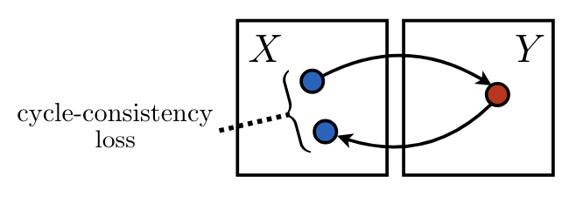
Loss Function
Adversarial Loss
ability to fool discriminator
Cycle Consistency Loss
let image to be similar to the original
“Unpaired image-to-image translation using cycle-consistent adversarial networks.” Zhu, J. Y., Park, T., Isola, P., & Efros, A. A. (2017).
Identity Loss
helps the generator to be an identity function
Notes:
Next is the Loss part; in this model, we need 3 different kinds of losses. The adversarial loss X to Y is the loss of generator G with respect to its ability to fool the discriminator such that the generated images (G(X)) look like they belong to domain Y; the loss is calculated using the Mean Squared Error.
Next, we encounter the Cycle Consistency Loss, shown on the left. It's a bit like a reality check. When our Generator G transforms an image to the Ghibli style and then back again with Generator F, this loss ensures the resulting image still resembles our original landscape. Lastly, we have the Identity Loss. It encourages our Generator to be a bit of a narcissist, reflecting the image back unchanged when it's already in the desired style. These two losses are calculated using L1 loss. Adding this loss up with some weight can get the total loss.

Slide 10
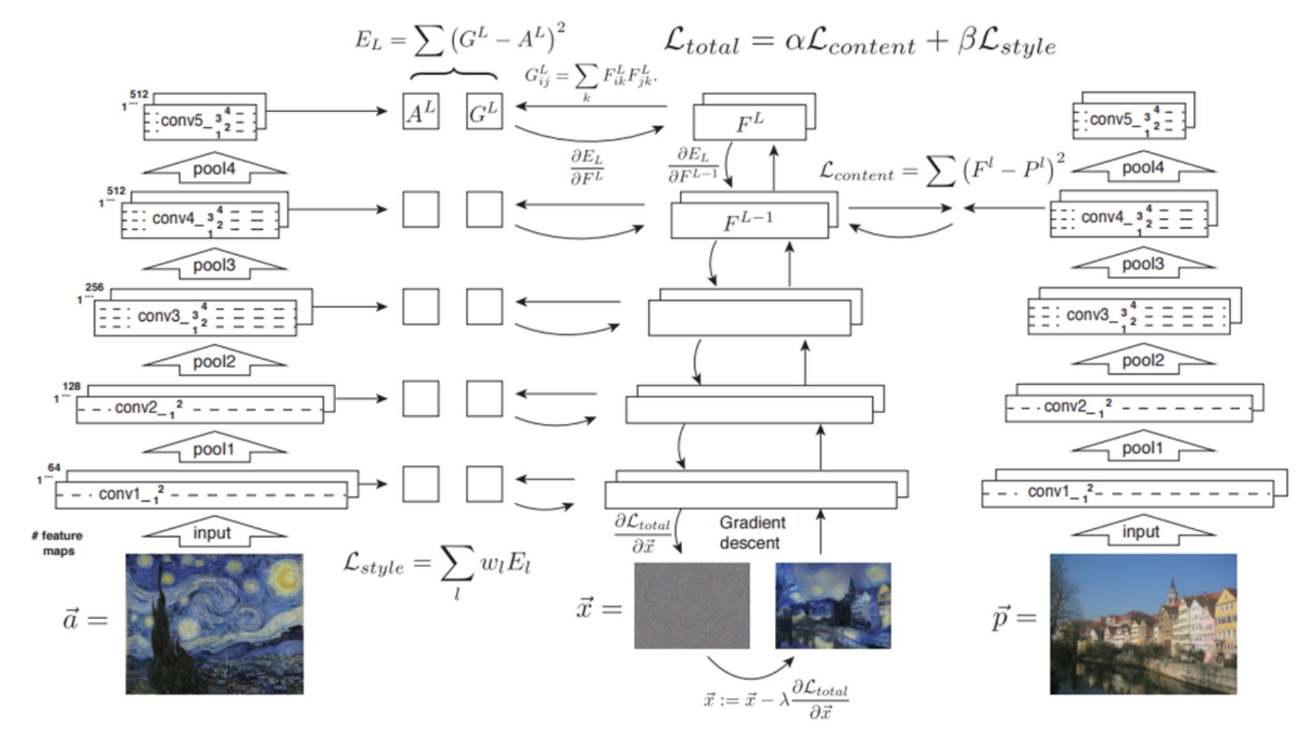
Neural Style Transfer
Style Loss
calculated every layer
Content Loss
calculated at fourth layer
L. A. Gatys, A. S. Ecker and M. Bethge, "Image Style Transfer Using Convolutional Neural Networks," 2016 IEEE Conference on Computer Vision and Pattern Recognition (CVPR)
Notes:
This is our other approach, Neural style transfer, NST for short. Here I will briefly talk about the structure and how it works. We used Vgg19 to extract the features from the style image and content image and used these features to calculate the losses. As shown on the left side of the image, style Loss ensures that the style is consistently infused across all network layers. As shown on the right side of the image, Content Loss, calculated particularly at the fourth layer, lets the final image retain its original content. The losses are calculated using the Mean Squared Error. Then, through a backpropagation process powered by gradient descent, NST iterates over and over, each time getting closer to an image that blends the original content with the new artistic style.

Slide 11
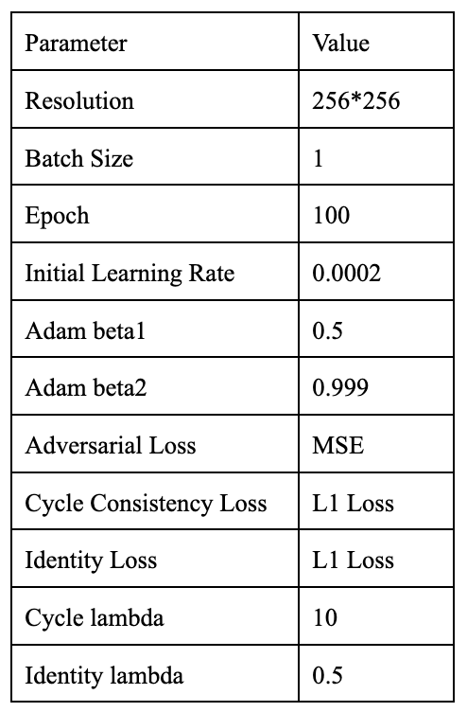
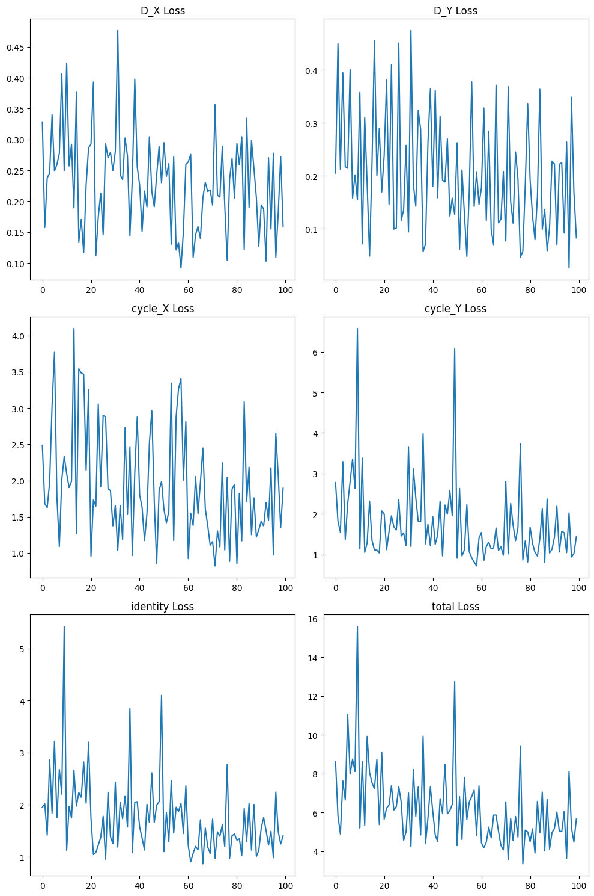
01
CycleGAN Experimental Settings
Notes:
despite some fluctuations, the loss curves showed a general downward trend, which indicates the model was learning as intended

Slide 12

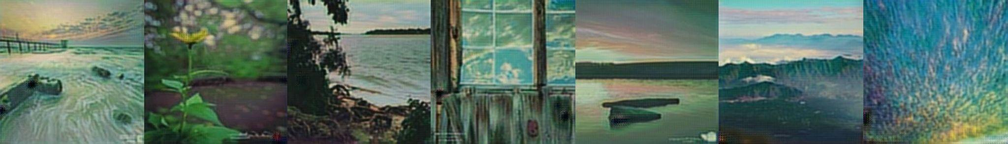
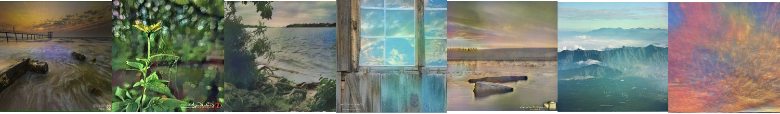
Demo
01
Original
CycleGAN
NST
Notes:
This slide presents a visual demonstration of our Ghibli-style transfer project. The top row features original landscape photographs. Below, are the output images from our two models: CycleGAN and NST.
In the CycleGAN row, we've turned real photos into scenes that look like they come from a Ghibli movie, complete with that fairy-tale feel and rich textures. The NST row has a softer look, making the landscapes seem like they're part of a dream, just like in a Ghibli film. Both ways show how AI can take a real place and make it look as magical as the animated world of Ghibli

Slide 13
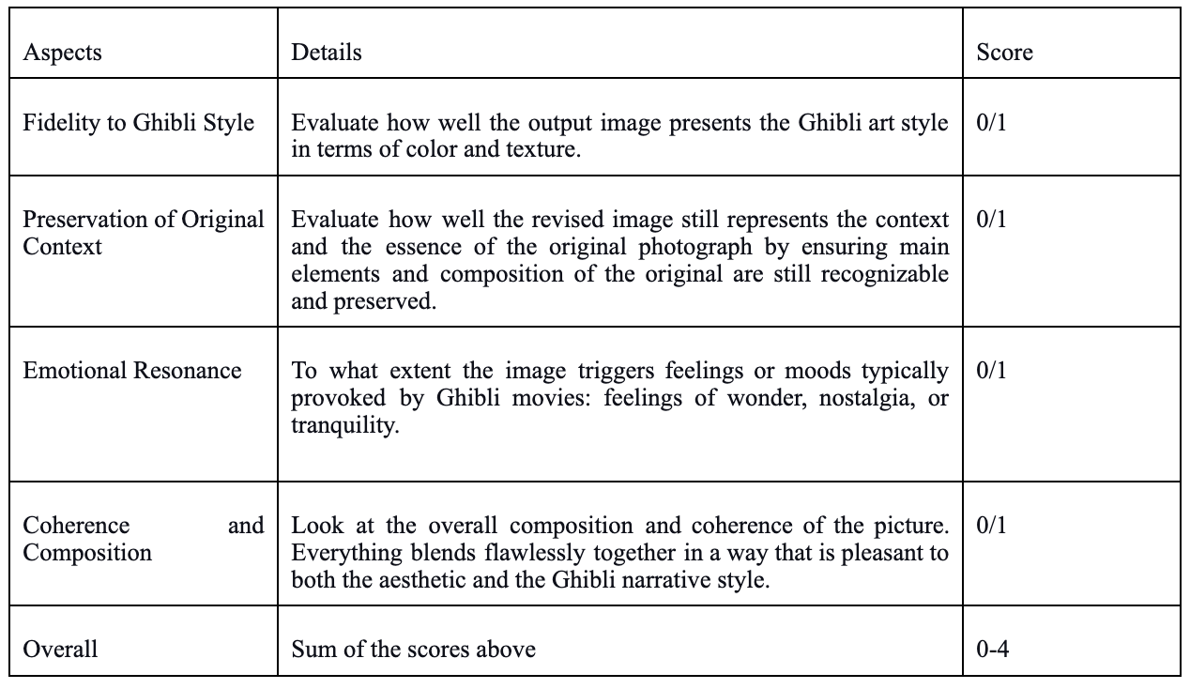
Human Evaluation
Model | Avg. Score
CycleGAN | 2.975
NST | 2.1625
Notes:
After explored some evaluation metrics for Generative models like FID score, we concluded that those metrics are not applicable to our tasks. So the team decided to do the human evaluation to our generative models.

Slide 14
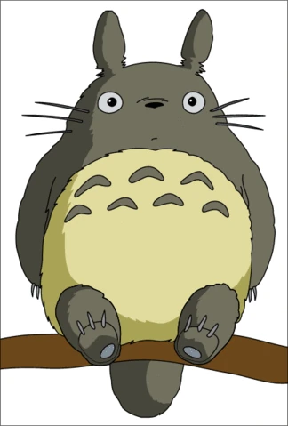
Conclusion
CycleGAN
Pros: learned from a great number of images
Cons: extensive training time.
NST
Pros: offers rapid style transfer
Cons: quality of the output is significantly influenced by the choice of reference style image
Notes:
Our project successfully fused the art style of Ghibli with real-world imagery using a CycleGAN and NST model, advancing the realm of image style transfer in deep learning. Based on the scores from the human evaluation results, the CycleGAN model outperforms the NST model in the transformation to the Ghibli style. In conclusion, for CycleGAN, pros is it learned from a great number of images, so it paid attention to details, enabling it to capture complex style nuances. such as color and texture. However, the main disadvantage of CycleGAN is it Requires extensive training time, making it less practical for quick applications. NST model, on the other hand, gives relatively good results with very high speed, since it uses a pre-trained model. However, the output quality from this style transfer network highly depends on the reference style image, which user needs to hand-pick every time. Therefore, the performance of the model can vary a lot.

Slide 15
Thank You
Q&A

